Slide 1
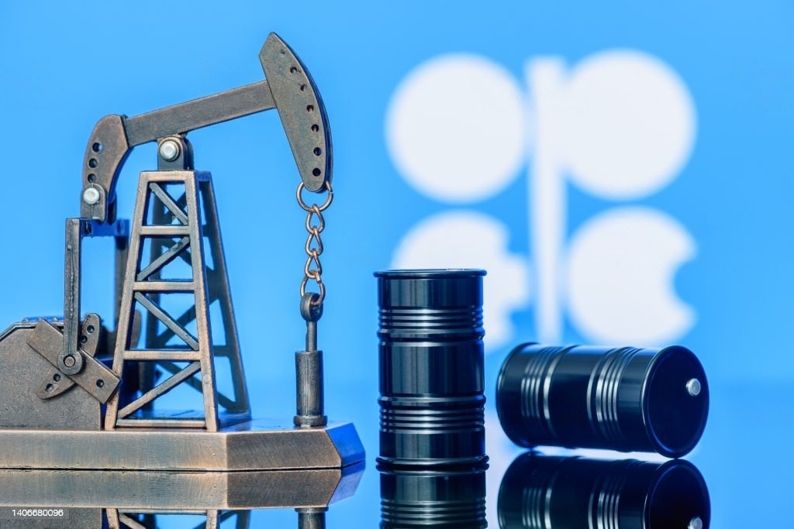

Analyze NYSE Data For Two Industries In Energy Sector
By Salim Al Maqbali

Slide 2
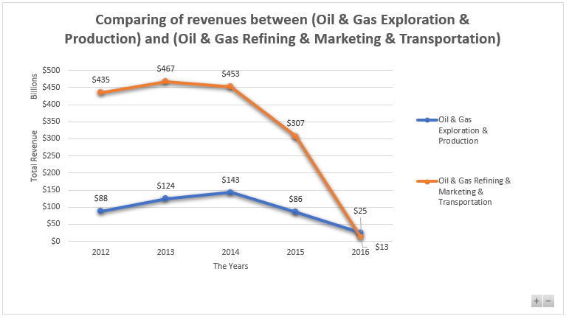
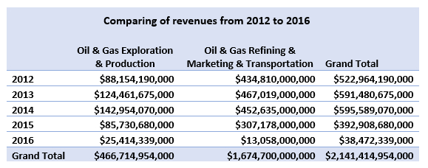

What is the revenue relationship between (Oil & Gas Exploration & Production) and (Oil & Gas Refining & Marketing & Transportation) in the energy sector?
The average total revenues of the oil and gas refining, marketing and transportation sector amounted to $434.8 billion, higher than that of the oil and gas exploration and production sector, which amounted to $88.1 billion. This means that companies in this sector generate revenues of an average of $346 billion, higher than companies in the oil and gas exploration and production sector.
Although the oil and gas refining, marketing and transportation sector has the highest average, it also has the highest standard deviation for total revenues, reaching $190.8 billion compared to the oil and gas exploration and production sector, which had a standard deviation of $45 billion. This means that investment in the oil and gas refining and marketing sector has more risks than the oil and gas exploration and production sector. For example, if we look at the period 2015 and 2016, the percentage of decline amounted from -32.14% to -95.75% in 2016, while in the oil and gas exploration and production sector, it amounted in the same period from -40.03% to -70.36%.
The total revenue range in the oil and gas refining, marketing and transportation sector amounted to 453.9 billion dollars, while in the oil and gas exploration and production sector it amounted to 117.5 billion dollars. We can conclude that the variance in the total revenues of companies in the oil and gas refining, marketing and transportation sector is greater and more widespread from the oil and gas exploration and production sector.

Slide 3
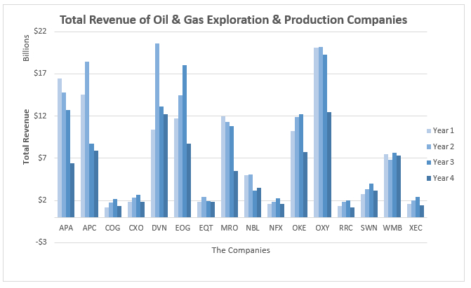
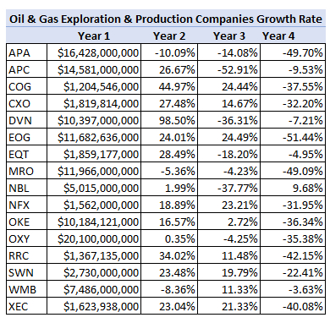
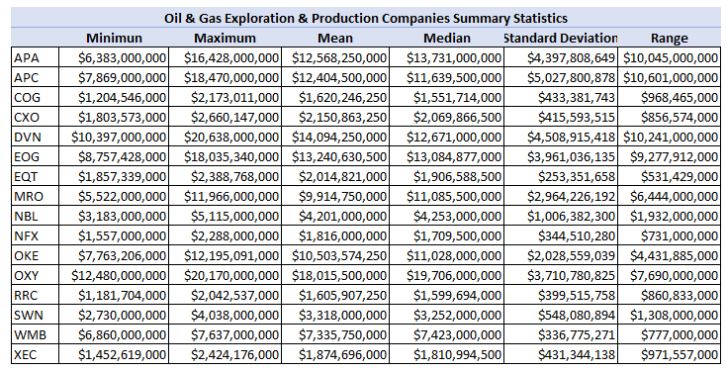
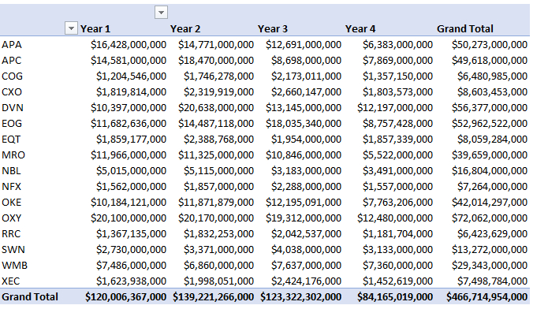
How were the revenues companies of Oil & Gas Exploration & Production during the four years for each company?
By the corresponding visualization scheme, we can see that most companies have achieved in the second year higher revenues than in the first.
The company of OXY achieved the highest percentage of revenue during the four years, amounting to $72 billion, with an average of $18 billion per year.
APC has the highest standard deviation rate of $5 billion compared to other companies, which means that this company is less stable, which makes investors reconsider investing in it.
APA, APC and DVN companies recorded the highest total revenue range with $10 billion over the four years, making them among the most widely distributed companies in this field.
DVN recorded the highest revenue growth rate of 98.50% in the second fiscal year.

Slide 4
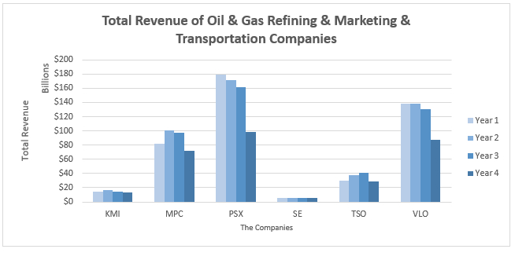
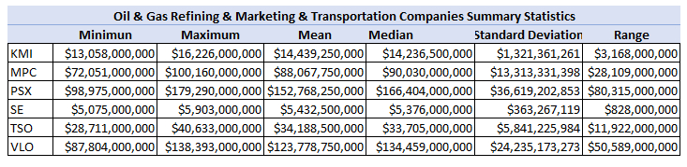
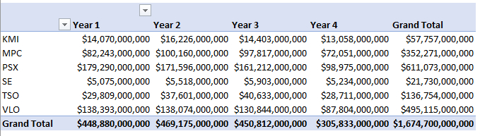
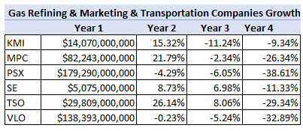
How were the revenues companies of Oil & Gas Refining & Marketing & Transportation during the four years for each company?
The highest share of revenue was for PSX, which amounted to $611 billion in the four years with an average of $166 billion.
Most companies recorded high losses in the third and fourth years, respectively, compared to the first and second years.
The highest standard deviation was $36.6 billion for PSX reaching -38.61% in the fourth year compared to the previous year. Which ranks it among the highest risk companies for investment.
PSX it also has the highest total revenue range of $80.6 billion compared to other companies, which makes it more prevalent in this field as well.

Slide 5
THANK YOU

